Slide 1
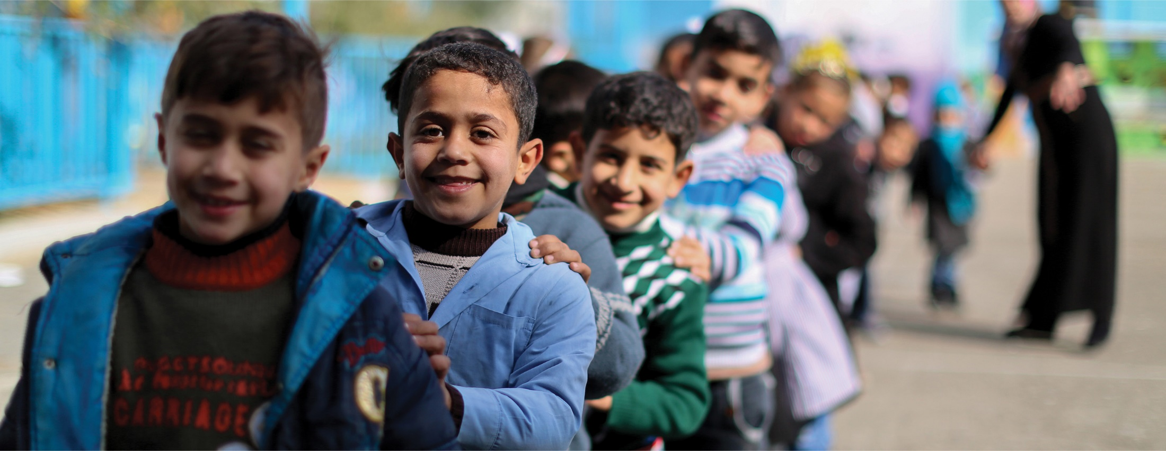


GLOBAL EDUCATION MONITORING REPORT
Migration, displacement
and education:
BUILDING BRIDGES, NOT WALLS
en.unesco.org/gem-report
gemreport@unesco.org
Notes:
Welcome to the launch of the 2019 Global Education Monitoring Report.
Before sharing some of the key findings and recommendations featured in the Report, I first want to thank our hosts, our speakers and our panellists who have travelled here today. We are extremely grateful for your willingness to share your experiences in addressing the education needs of people on the move.

Slide 2

The 2030 Agenda for Sustainable Development commits us to leave no one behind
Refugees and internally displaced persons and migrants
are among those
1 in 8 are internal migrants
who are vulnerable
[and] must be empowered
1 in 30 are international migrants
1 in 80 are displaced
One of their vulnerabilities
but also one of their strengths
is education
Notes:
Fulfilling its mandate to monitor progress on education in the SDGs, the Report shows the distance that the world needs to cover to reach the targets agreed for 2030. A key challenge is to fulfil the commitment to leave no one behind.
Migrants, refugees and internally displaced people are among those groups who may be left behind. Those who want to escape poverty or persecution. Those who may seek better education, employment opportunities or just security.
The report has taken the widest possible interpretation of migration, voluntary or forced.
It covers internal migration, where an estimated 1 in 8 people live in a different province to the one they were born. Apart from those who move from villages to cities, there are hundreds of millions who move regularly, as seasonal workers or nomads.
It addresses international migrants, who are nationals of another country living abroad. They make up 257 million or about 1 in 30 people. This does not include the children of immigrants, the so-called second generation, for whom the education challenges can be similar.
And, last but not least, it looks at the 1 in 80 people who have been displaced due to conflict or natural disaster, whether internally or across borders, as refugees or asylum seekers. The daunting prospect of displacement due to climate change is only briefly touched upon.
But this is not a report on migration and displacement per se. It is a report how these movements interact with education. It is about how teachers and education planners respond. It is about the need that migrants and refugees have for education to thrive in their new homes, to feel they belong.

Slide 3

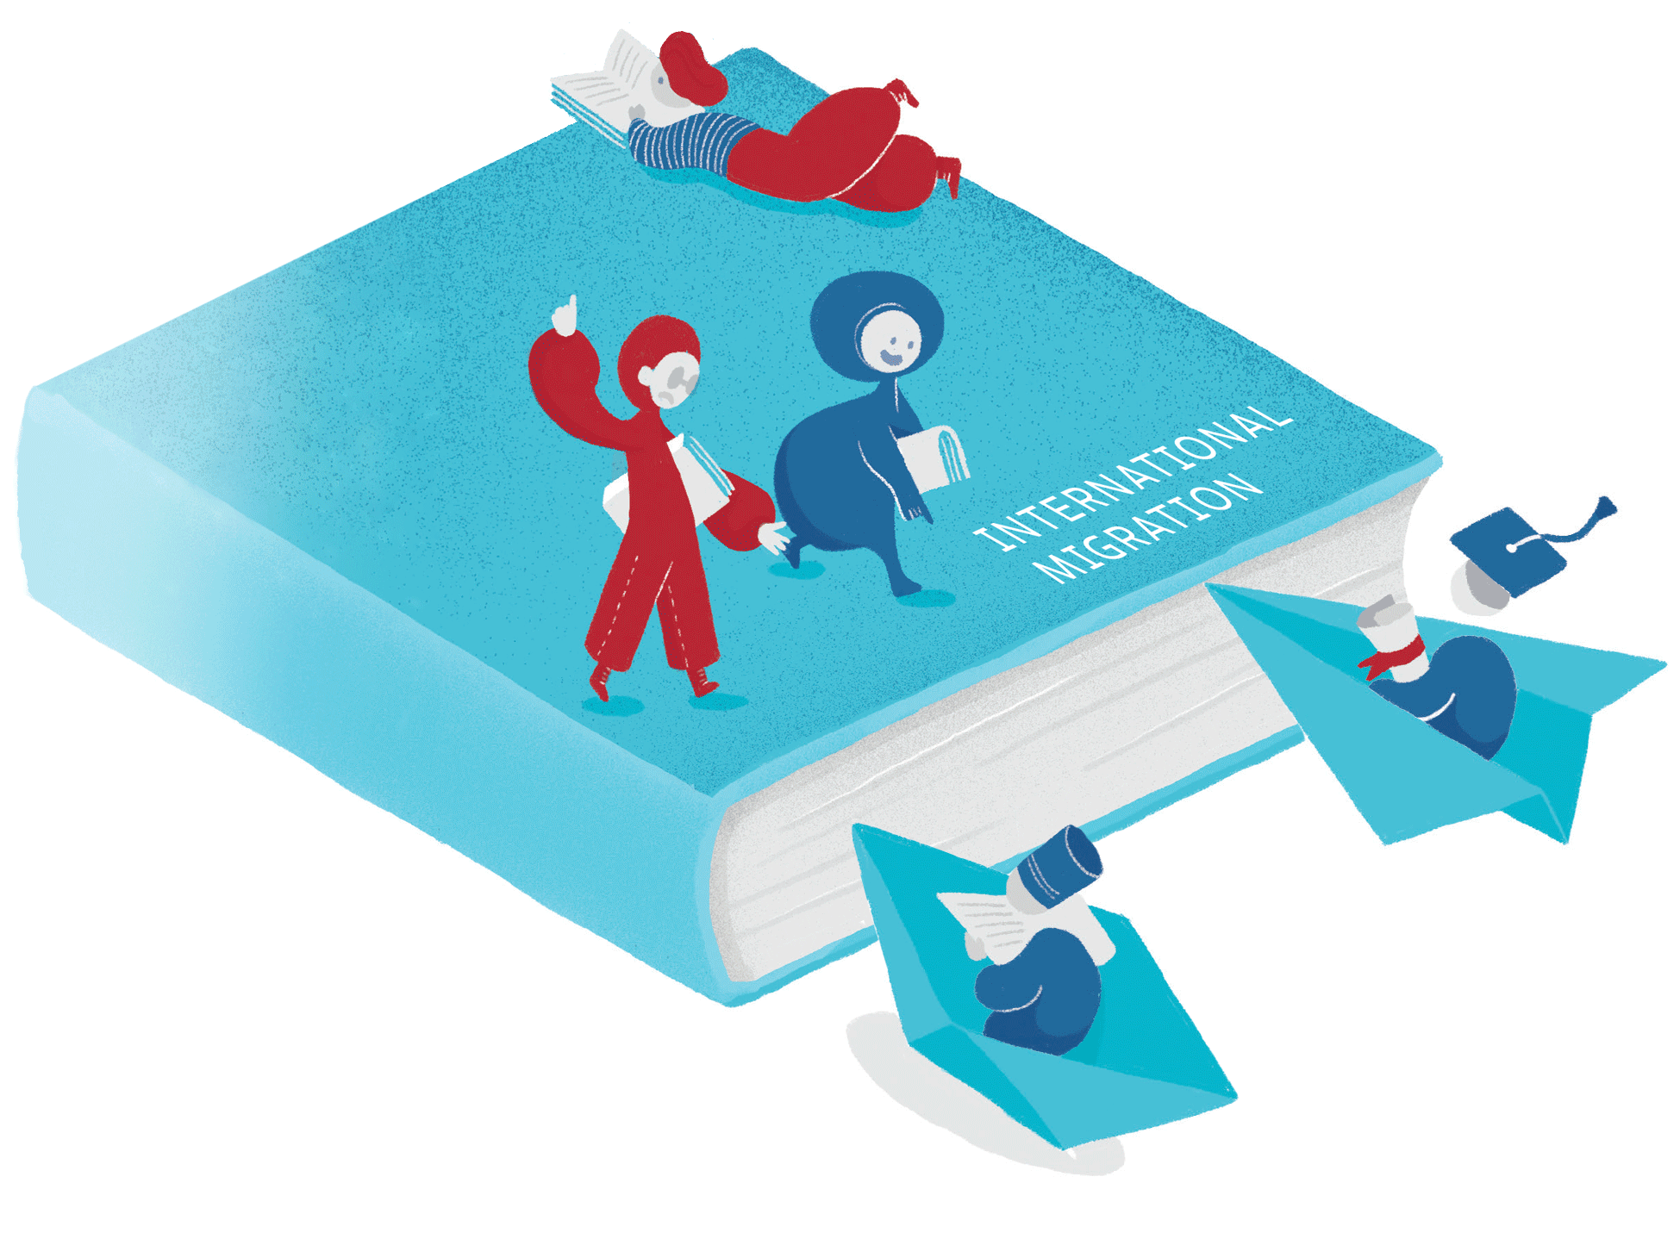
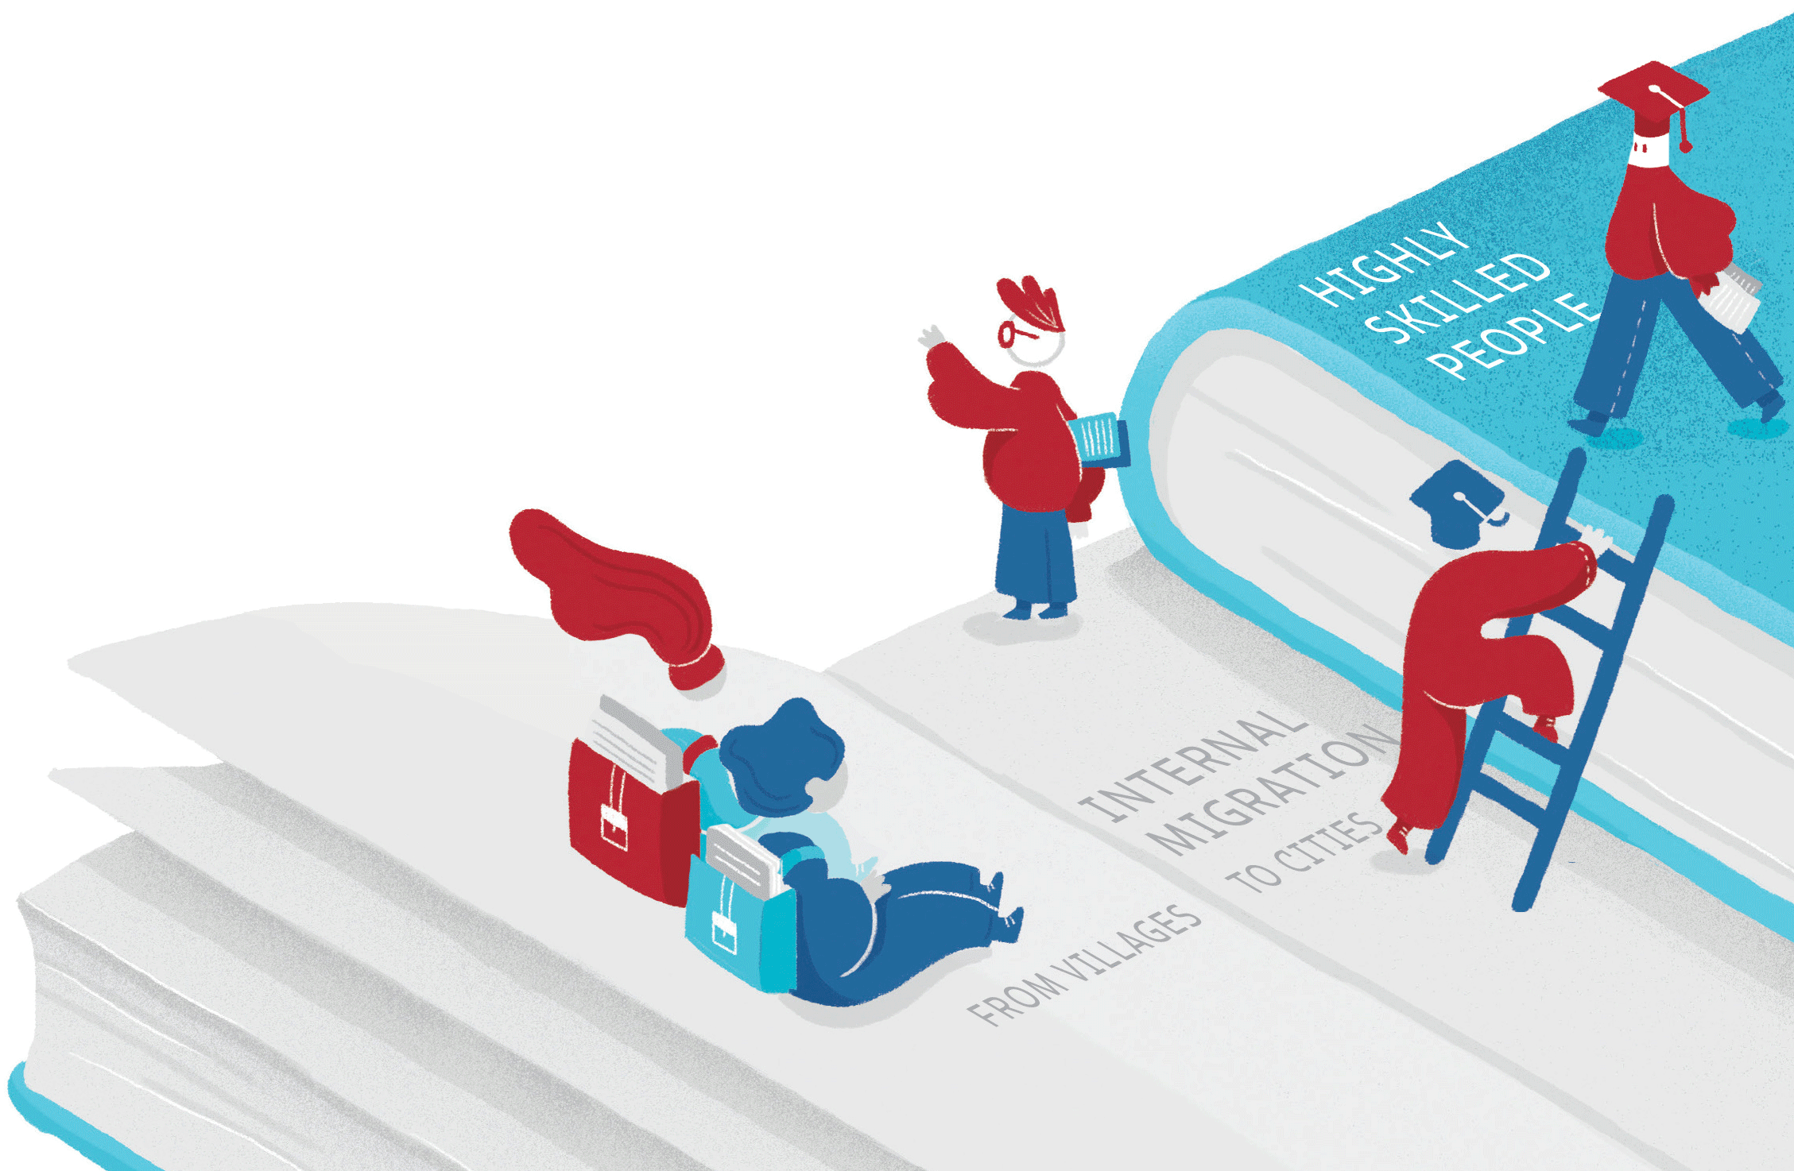
MIGRATION
and DISPLACEMENT 
EDUCATION
Internal migration leads to:
CHILDREN LEFT BEHIND
One in three in rural China
International migration leads to:
BRAIN DRAIN
At least 1 in 5 skilled people
emigrate from 27% of countries
Displacement leads to:
EMERGENCIES
Half of refugees are under 18
Notes:
Migration and displacement can have both negative and positive effects on education systems. Let us start with the challenges.
[CLICK] Internal migration leads millions of children of migrating parents to be left behind. More than one in three children were left behind in rural China in 2015. Urbanization and related demographic changes lead to large scale school consolidation in many middle income countries: half of rural schools closed in China and the Russian Federation in 10 to 15 years. They also lead to growing slums where education provision is scarce.
[CLICK] International migration affects sending countries’ education systems, particularly some of the smaller ones: at least one in five skilled people emigrated from 27% of countries.
[CLICK] Displacement particularly affects low income countries, which account for 10% of the population but 20% of the refugee population. Refugees more than migrants are of school age: half of them are under 18. They often arrive in parts of their host countries that already have poor education.

Slide 4




MIGRATION
and DISPLACEMENT 
EDUCATION
International migration leads to:
EDUCATION OPPORTUNITIES
Children of Colombian migrants in USA had 2 years of education more
than children of non-migrants
EXCHANGE AND MOBILITY
    In half of countries at least 6% of students emigrate
Internal migration leads to:
EDUCATION OPPORTUNITIES
Migrants from rural Indonesia had 3 more years of education
Displacement leads to:
REFUGE
There were 12,700 attacks on schools
in conflict-affected countries
Notes:
But migration and displacement also represent an opportunity.
[CLICK] Children who move from rural to urban areas often acquire more education than those who did not move. In Indonesia the gap was three years
[CLICK] Children of international migrants also tend to benefit. Children of Colombian immigrants to the United States had at least 2 more years of education than children of people who did not migrate.
When we talk of migrants, this also includes students studying abroad – the case for at least 6% of students in half of countries.
[CLICK] Refugees may be leaving their homes but also leave insecurity behind: there were 12,700 attacks on schools between 2013 and 2017 in conflict-affected countries.

Slide 5

EDUCATION
MIGRATION
The more educated…
…are more likely to migrate
…are more likely to be open to immigrants and immigration
Compared with primary education graduates, tertiary education graduates are
2x as likely to migrate internally
5x as likely to migrate internationally
Notes:
In turn, education is a potent factor shaping migration flows.
[CLICK] The higher the education level, the higher the probability of migration. Those with tertiary education are twice as likely to migrate from villages to cities and five times as likely to emigrate abroad as those with primary education. A point often missed in public debates is that, with relatively few exceptions, immigrants are more educated than natives on average, even in countries that do not pursue selective immigration policies.
And education is a critical – even if contested – factor shaping attitudes towards immigration. A 2017 survey from across 140 countries showed that the higher the level of education, the higher the level of openness to immigration levels staying the same or increasing.

Slide 6




EDUCATION
Inclusive education for migrant
and displaced populations:
addresses causes of tension
helps realise their potential
supports communities back home
❑
MIGRATION
and DISPLACEMENT
Lowering the cost for migrants
to send money home
from 7% to 3%
would provide US$1 billion
for education
Notes:
But education’s role is potentially much more important than what these relationships suggest.
[CLICK] An inclusive education system can:
Address causes of tension,
by helping host and immigrant communities interact and live together
or by providing equal opportunities
Help immigrants and refugees realise their potential, which is often wasted
Ultimately help immigrants and refugees earn a living and support communities back home through remittances and other mechanisms
[CLICK] The Report shows that if the cost of remitting money abroad fell from 7% to the SDG target of 3%, $1 billion could be generated for education.

Slide 7

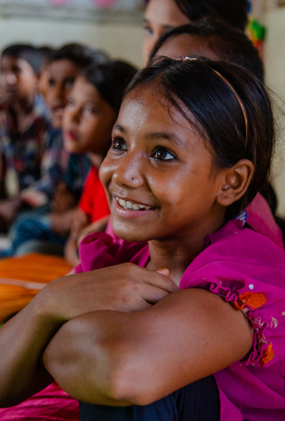
Two new global compacts
on migrants and refugees
will be signed this year
with education commitments
How should countries achieve these commitments?
Notes:
The importance of these relationships is why education-related commitments have made their way into the two global compacts on migrants and refugees that are being signed by almost all countries in the world this year.
But how should these commitments be achieved? What are priority actions? The report makes seven recommendations.

Slide 8







Protect their rights
1
In just 2 years since the New York Declaration…
Don’t let ID documents or residence status block enrolment
Make education and immigration laws consistent
Do not let school leaders add extra barriers
Put formal processes in place to respond to rights’ violations
…refugees have missed
1.5 billion days of school
Jordan started allowing children to enter public schools without identification cards in 2016
Notes:
[1] Governments need to protect the right to education of all people on the move.
Just two years after the New York Declaration, where countries committed to provide education to refugees within 3 months, 1.5 billion school days of refugees have been lost.
Countries from Australia to Hungary and from to Indonesia to Mexico for example, are still providing limited or no education to asylum-seeking children in detention.
[CLICK] Countries need to protect migrants’ and refugees’ right to education, regardless of ID documents or residence status. Jordan tackled this after initial obstacles by allowing Syrian refugee children to enter public schools without ID cards in 2016, for instance.
[CLICK] Make education and immigration laws consistent with each other
[CLICK] Do not allow discretion in interpreting laws at local level.
[CLICK] And put formal processes in place to inform migrants and refugees of their right to education and respond to the violation of this right.

Slide 9
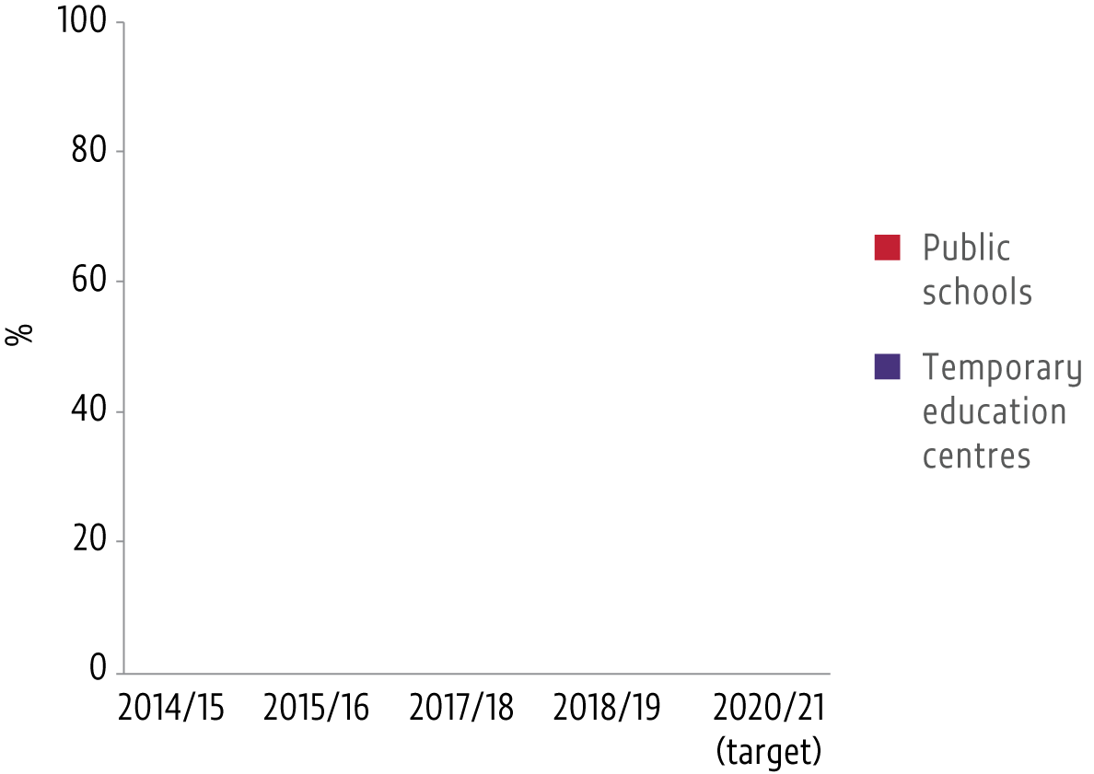
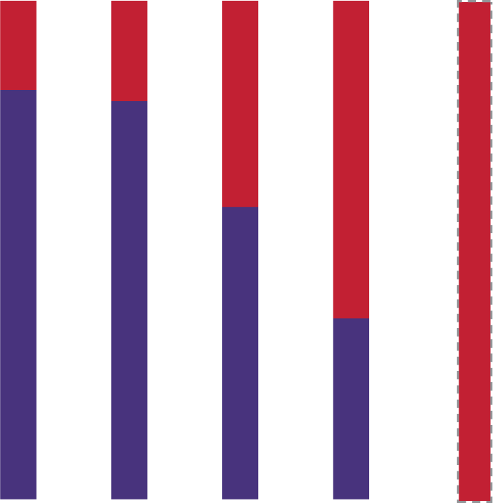
2
Include them in national systems
Refugees should:
spend minimal time in schools not following national curricula
Immigrants should:
not be segregated
spend as little time as possible in preparatory classes
not be separated into slower school tracks
Turkey has committed
to include all Syrian refugees
to its national education system by 2020
8 of the top 10 refugee hosting countries include them in national education systems including Chad, Ethiopia, Lebanon and Uganda
Notes:
[2] Migrant and refugee children need to be included in the national education system.
Turkey has committed to include all Syrian children in public schools by 2020.
[CLICK] Refugees should:
● spend minimal time in schools that do not follow the national curriculum
8 of the top 10 hosting countries include refugees in national education systems, including countries such as Chad or Ethiopia
[CLICK] Immigrants should:
● not be segregated: they should not be concentrated in specific schools, as in so many European countries today.
● they should spend as little time as possible in preparatory classes: inclusion means interacting with their peers.
● they should not be separated into slower, often vocational, school tracks, which compromises their future opportunities.

Slide 10
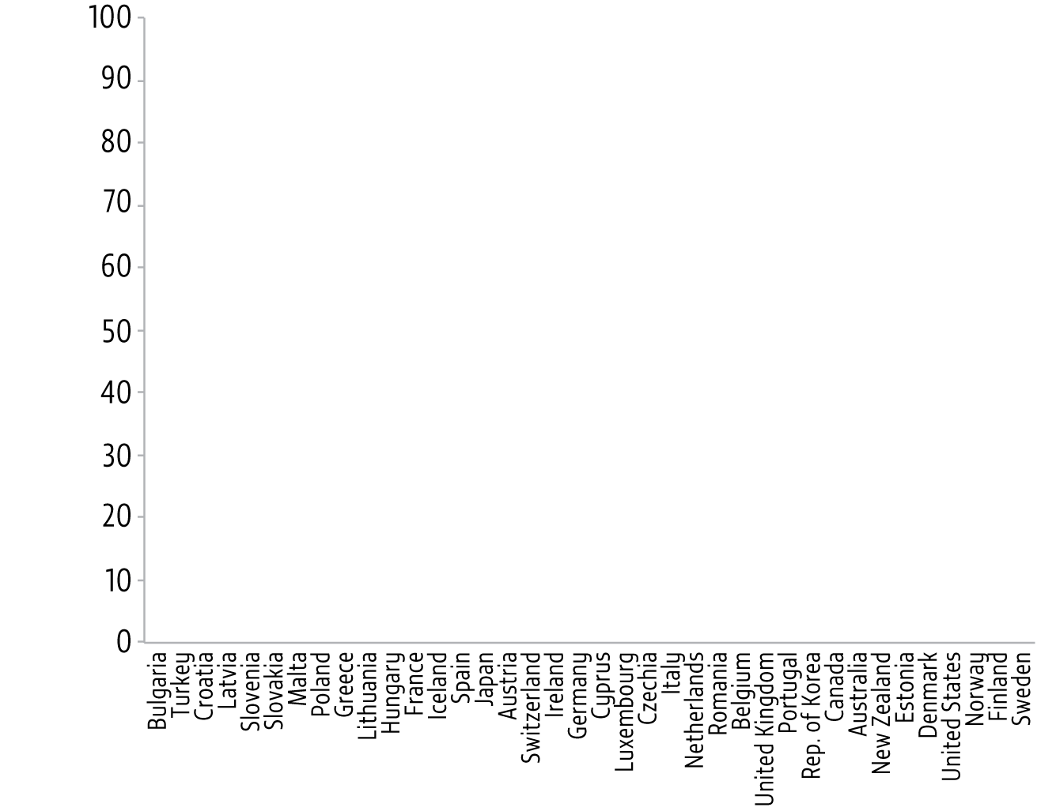
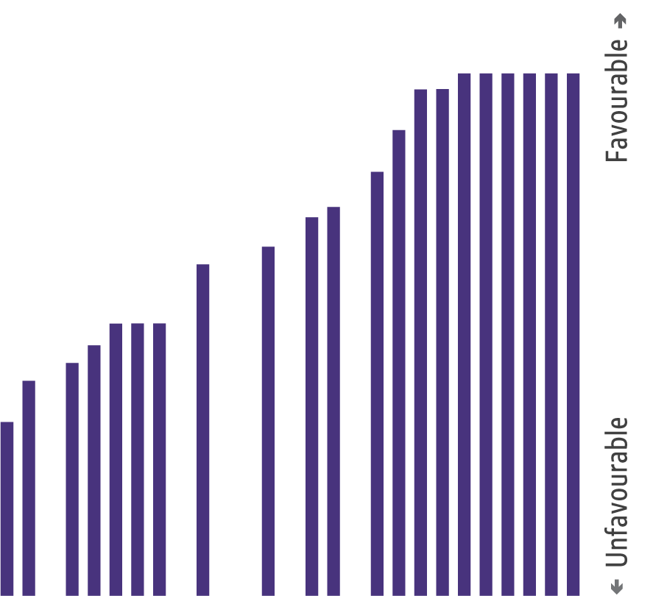
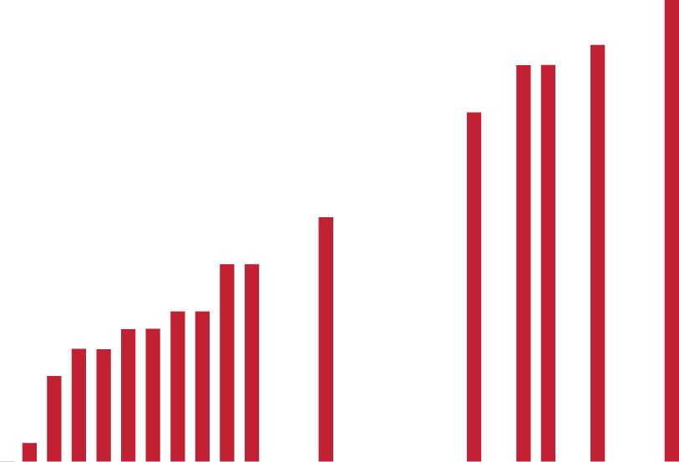
3
Respond to their needs
How well countries integrate immigrants
in education in high income countries
Provide language and other facilitating programmes
Provide alternative, preparatory and accelerated education programmes
Help overcome cost barriers
Provide financial education programmes
A cash transfer in Lebanon increased refugee school attendance by 20%
Notes:
[3] Including migrants and refugees in national education systems is only the beginning. A plan is needed to respond to their needs.
Not all countries do this successfully. This graph shows that countries in southern and eastern Europe – highlighted in red – are struggling to prioritize their needs.
[CLICK] Countries need to provide language programmes.
[CLICK] They need to provide accelerated education programmes where education trajectories have been interrupted. The Norwegian Refugee Council runs an accelerated learning programme in the Dadaab refugee camp, which condenses Kenya’s 8-year curriculum into four years.
[CLICK] Refugees need support to overcome cost barriers. Cash transfers in Lebanon increased attendance by about 20%.
[CLICK] Adult migrants need financial education to manage remittances.

Slide 11
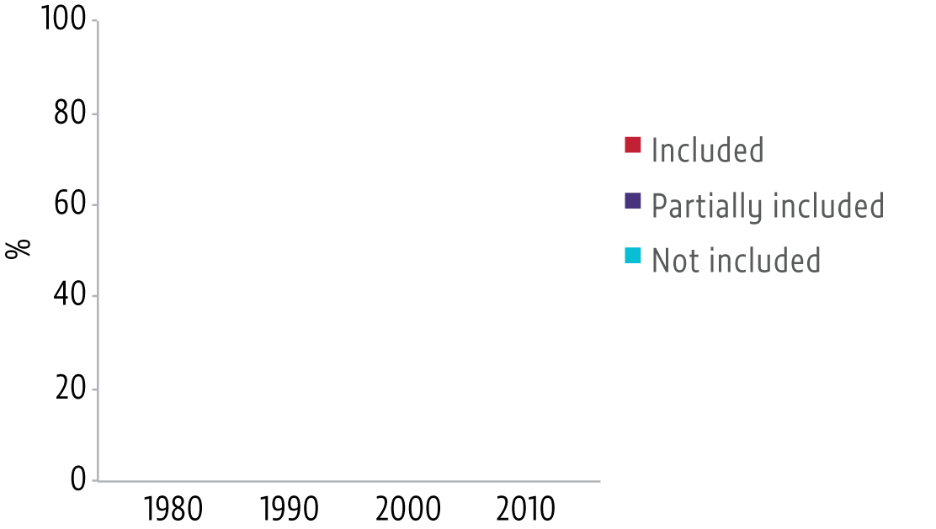

4
Recognize their histories
Adapt curricula and re-think textbooks so that they:
  respect past history and
  current diversity
  recognize contributions of immigrants and refugees
  promote openness to multiple perspectives
Two thirds of 21 high income countries
have introduced multicultural education
at least partially
81% of those who took part in the Eurobarometer survey agreed that
school materials should include information on ethnic diversity
Notes:
[4] Countries need to grapple with their curricula and textbooks.
Education can challenge prejudices and develop skills for living together. Yet, only a quarter of high income countries have fully included multicultural education and a little over two-thirds have done so at least partially.
Yet, 81% of those who answered the Eurobarometer survey agreed that school materials should include information on ethnic diversity.
[CLICK] Adapting curricula and textbooks involves:
- respecting past history and current diversity
- recognizing the contributions of immigrants and refugees
- promoting openness to multiple perspectives and encouraging critical approaches

Slide 12
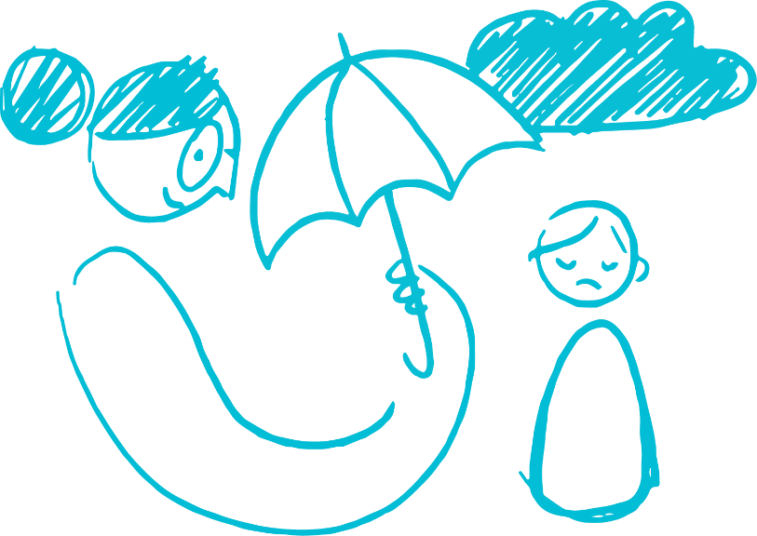

5
Prepare their teachers
In the Syrian Arab Republic
Train teachers to:
deal with diversity
confront stereotypes and discrimination
recognize stress and trauma and refer those in need
Relieve teachers from conditions of extreme hardship
73% of teachers had no training on how to provide
psychosocial support
In Iraq, the Education Cluster brought partners together to coordinate incentives for internally displaced teachers
Notes:
[5] The key to these challenges is supporting teachers to take on this complex responsibility.
Almost three quarters of teachers in Syria had no training on providing psychosocial support.
[CLICK] It is necessary to train teachers:
[CLICK] …to deal with diversity
[CLICK] …to confront stereotypes and discrimination
[CLICK] …to recognize stress and trauma and refer those in need to specialists
[CLICK] It is necessary to recognise the hardship under which some teachers are expected to work. In Iraq, fragmented support to internally displaced teachers led to pay disparities and tensions. The Education Cluster brought all partners together to coordinate incentives.

Slide 13
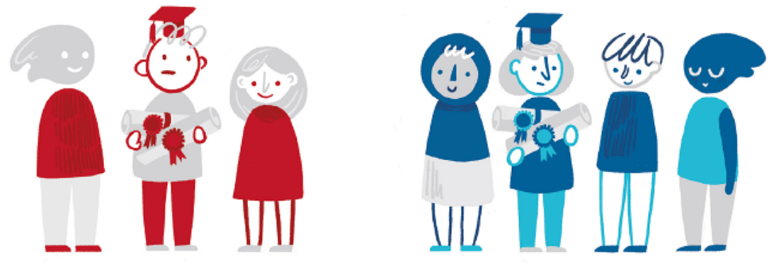
6
Harness their potential
Among those with tertiary education in richer countries…
Reform institutions to accept qualifications earned all over the world
Streamline and simplify systems for certifying skills
over 1/3 of immigrants
but 1/4 of natives
are overqualified for their jobs
Germany offers opportunities to identify and evaluate undocumented occupational competences
Notes:
[6] Unfortunately the skills of migrants are often not being fully deployed despite their potential to contribute to their host communities and societies.
Among those with tertiary education in high income countries, immigrants were more likely to be overqualified for their jobs than natives.
[CLICK] To address such challenges, it is necessary to: reform institutions to make the recognition of qualifications earned abroad more efficient
[CLICK] Streamline and simplify systems for certifying skills acquired informally. Germany offers opportunities to identify and evaluate undocumented occupational competences.

Slide 14
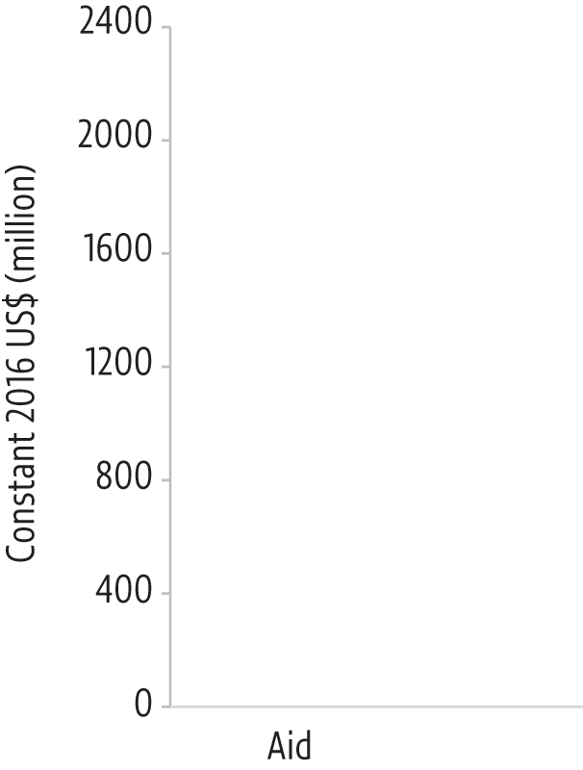

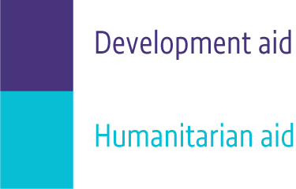
7
Reform humanitarian/development aid
Humanitarian and development actors must co-ordinate to provide predictable, multi-year funding
Multisector humanitarian plans should include education
Only a third of the funding gap for refugee education has been filled
Uganda brought together humanitarian and aid partners to prepare its education response plan
Notes:
[7] Financing education for migrants and refugees has its cost implications.
In the case of immigrants, the medium- to long-term fiscal impact is small. After taking into account what services they use and what taxes they pay, the cost does not exceed -/+1% of GDP. But more could be done to target funds where they are needed most.
[CLICK] In the case of refugees, the report has estimated that $800 million was spent on their education in 2016, roughly equally split between immediate-response humanitarian aid and long-term-response development aid.
[CLICK] Planning for both needs to be done jointly with the government in charge, as Uganda recently did so successfully. The momentum around Education Cannot Wait should be used.
[CLICK] And multi-sector planning should include education.

Slide 15
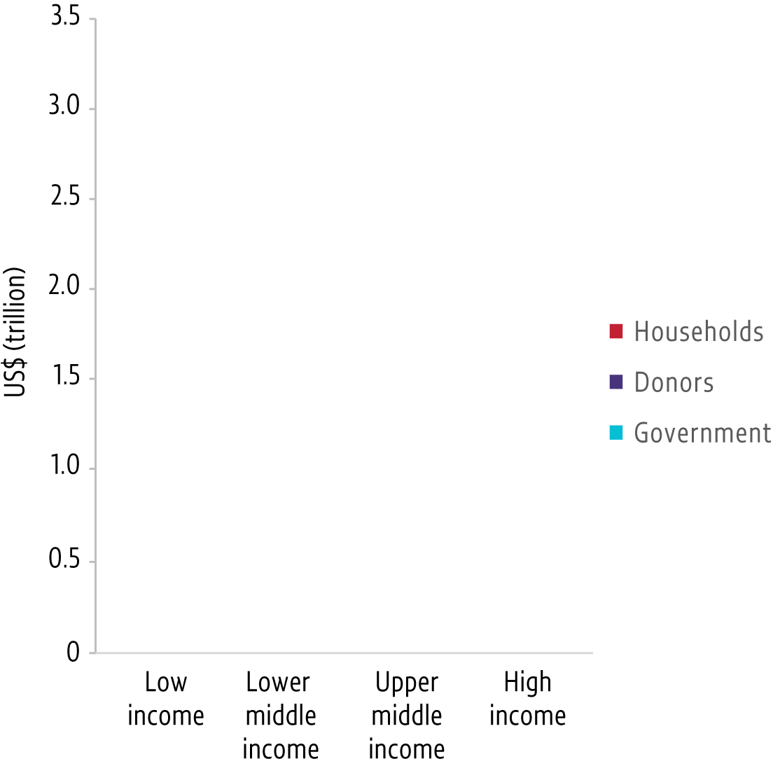
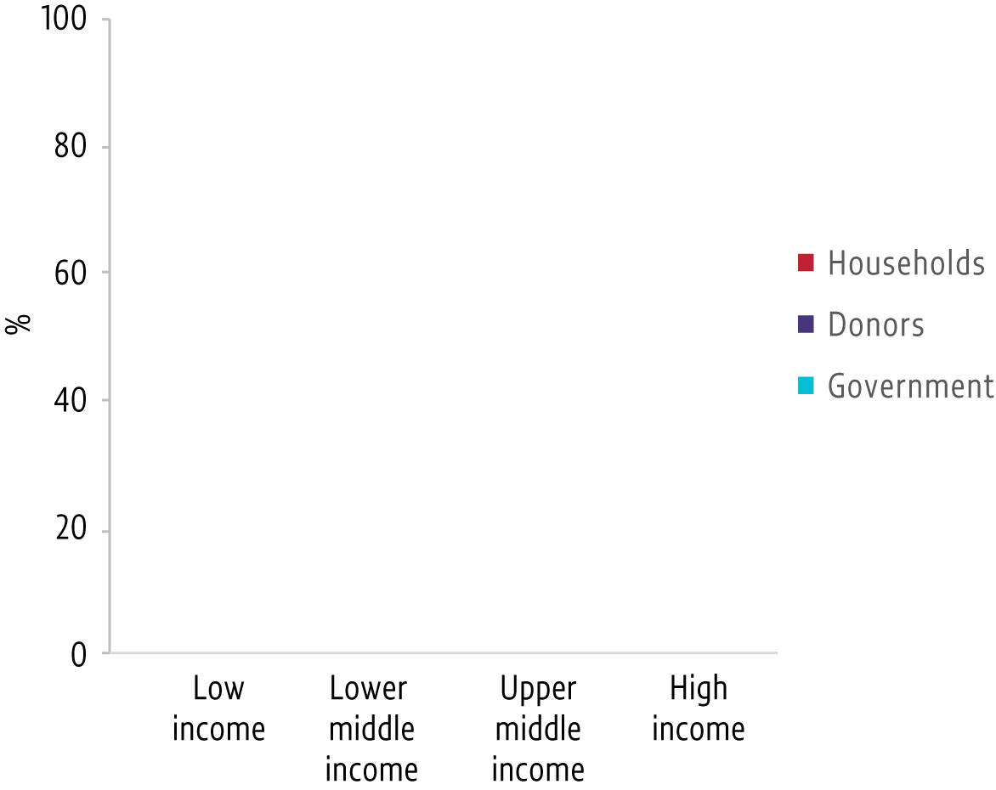
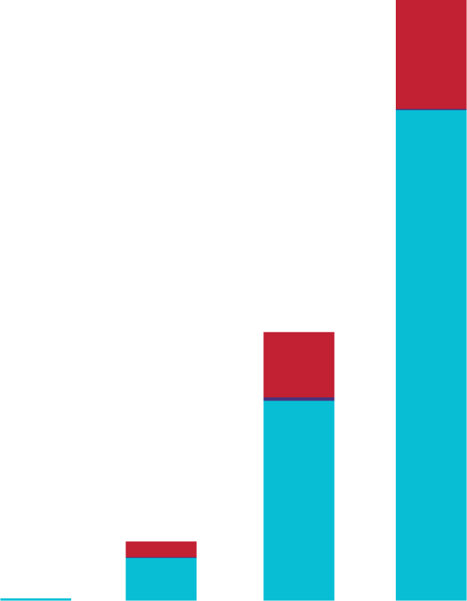

Funding does not reflect global priorities
Only 0.5% of all global spending on education goes to low income countries
A third of the cost of education is
paid out of households’ pockets
in low income countries
65%
0.5%
Notes:
This brings in mind the wider challenges of financing education
[CLICK] Analysis for this report shows the vast disparities. Low income and high income countries have about the same school age populations but the former absorb just 0.5% of total global spending on education, while the latter get the lion’s share at 65%.
[CLICK] Spending also needs to be more equitable in other ways. Households bear a much larger share of education costs in low income than in high income countries.

Slide 16
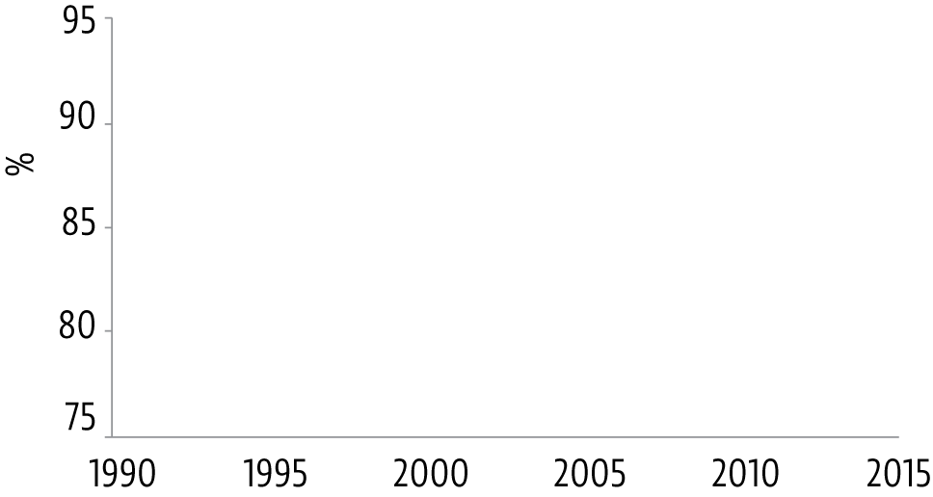
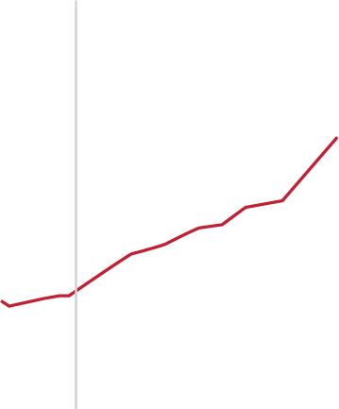
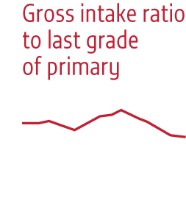


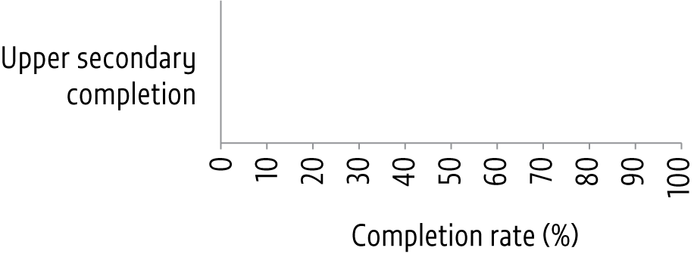



Many more are not completing school
Advances in primary school completion have stagnated globally
49% completed secondary school globally
18% in low income countries in 2013–17
In the European Union
2x as many foreign-born students as natives
left school early in 2017
Notes:
Finance is an important factor.
[CLICK] The mobilization of the international community to increase aid in the late 1990s is one of the factors credited with the advances observed towards universal primary completion in the years that followed. But the financial crisis led to aid stagnation. Primary completion rates have also stagnated at less than 90% since the late 2000s.
[CLICK] Today, our agenda is more ambitious aiming for universal secondary completion. Yet only 49% complete secondary school globally, while the ratio is just 18% in low income countries – and just 1% among the poorest girls.
[CLICK] But even in high income countries in Europe, young people of migrant background are twice as likely to leave school early as natives.

Slide 17


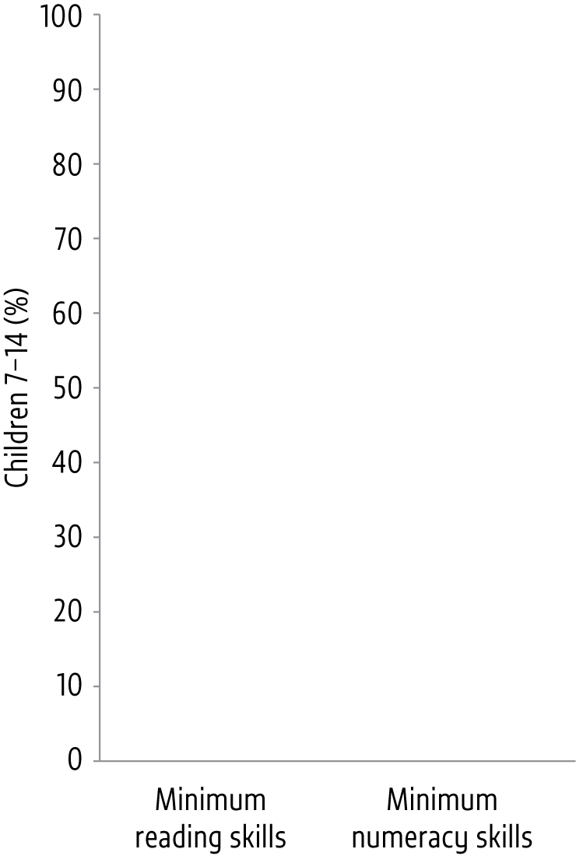
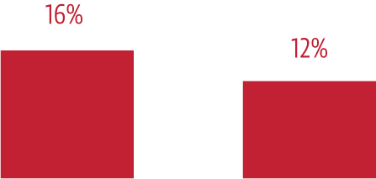
…and not learning even the basics
Students with immigrant backgrounds
in OECD countries were
32% less likely than natives…
Low income countries
have a much longer way to go
e.g. Sierra Leone in 2018
…to achieve basic skills in reading, mathematics and science in 2015
The share of grade 4 students with minimum reading skills in middle and non-OECD high income countries
increases by less than 1 percentage point each year
Notes:
In fact, our agenda is even more ambitious than that, aiming also for everyone to achieve at least a minimum learning level.
[CLICK] First-generation immigrant students in OECD countries were a third less likely than natives to achieve basic skills in reading, mathematics and science in 2015.
[CLICK] In middle income and non-OECD high income countries, progress is slow. On average, the share of grade 4 students reaching minimum reading levels has increased by less than one percentage point per year over the past 15 years.
[CLICK] And low income countries start from an even lower point. In Sierra Leone, fresh evidence from UNICEF shows that, among children, only 16% had basic reading skills, and only 12% had basic numeracy.
Ambitious it may be, but the monitoring framework of SDG 4 is helping keep our attention focused on what matters to achieve sustainable development. And this includes a focus on groups, such as refugees and migrants, who may be falling behind.

Slide 18
Join in the discussion and our campaign for education
following migrants and refugees:
#EducationOnTheMove
Download the report:
bit.ly/GEM2019
Notes:
Please do share the messages of this report. At the link on this slide, you will find report materials in multiple languages and formats.
We will now watch a short video summarizing our key findings before moving on. Thank you for listening.

